Slide 1
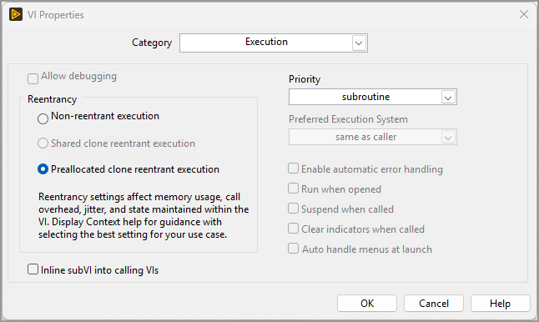
LabVIEW Multithreading and VI Execution Settings
The recommended execution settings to achieve maximum performance while avoiding IDE slowdown. Recommended for most small, “pure” VIs, including low-level reusable VIs.
Event: GDevCon #7 (Brussels, Belgium)
Presentation Date: Wednesday, 23 September 2026
Notes:
By “pure” VIs we mean VIs that take one or more inputs, perform computations on those input values, and produce one or more output values. Such VIs do not read/write global variables or FGVs, do not send or receive asynchronous messages (queues, notifiers, events), do not control hardware, do not perform file I/O, do not send network messages.

Slide 2






Presenter
Petru Tarabuta MEng MIET | Test Systems Engineer, founder and director of Robusto Systems Ltd
Contact Details
Email: petru@robustosystems.com
Tel: 01452 452 165
Robusto Systems Ltd (UK)
www.robustosystems.com
Notes:
Hello. I am Petru. It’s an honour to present at GDevCon again.
I was born and raised in Romania. I went to university in the UK and have lived and worked in the UK ever since. I help customers implement test, measurement, and control systems through my company, Robusto Systems. I primarily use LabVIEW, but also use TestStand, C# and SQL.
Contact Details
Petru Tarabuta MEng MIET CLA CTD CPI LabVIEW Champion | Test System Engineer
Robusto Systems Ltd
petru@robustosystems.com
01452 452 165
www.robustosystems.com

Slide 3
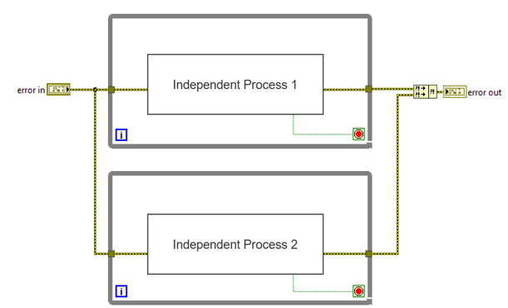
Introduction
A key advantage to LabVIEW is its ability to create parallel code easily. Code consisting of two parallel loops is rightly introduced as early as the first lesson of LabVIEW Core 2.

Slide 4
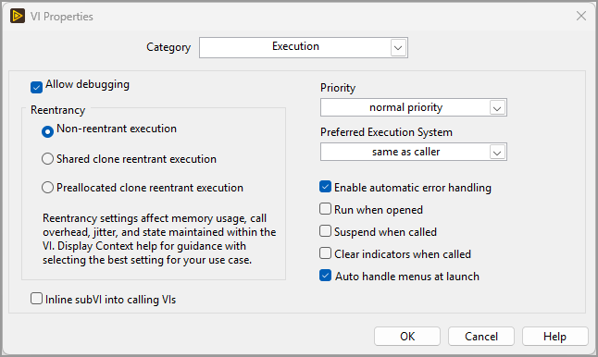
Introduction
Creating simple multithreaded code is easy.
Creating highly multithreaded, high-performance code is difficult. It requires mastering concepts such as reentrancy, priority, and preferred execution system.
This talk will:
  Explain VI execution settings
  Present experiments that illustrate the effect of various settings
  Recommend when to use each setting
  Reference LabVIEW Idea Exchange ideas that describe potential improvements to LabVIEW itself
These concepts are foundational. They apply to all VIs and LabVIEW apps, regardless of higher-level organisation patterns such as which framework is being used. They can be particularly relevant to creating high-performance reusable libraries.
The default VI Execution settings configuration when a new VI is created.

Slide 5
Disclaimer
LabVIEW multithreading is a large topic. A comprehensive treatment, such as a manual containing text, diagrams and code examples, would cover hundreds of A4 pages. Such a manual does not exist yet.
This 30-minute presentation is naturally only the tip of an iceberg. Nevertheless, it should be useful to most programmers.

Slide 6
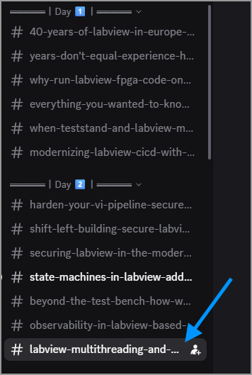
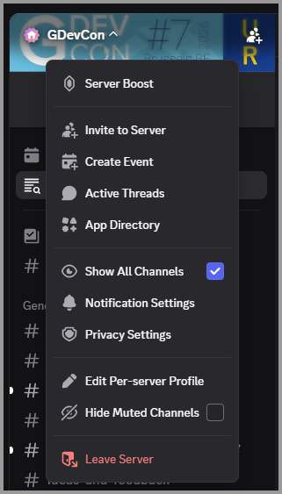
Questions
Please ask questions at the end of the presentation and in the dedicated Discord channel. I will reply to every question or comment made on Discord.
Notes:
Please note that, to see the dedicated presentation chat you may need to enable “Show All Channels” in the Discord settings associated with the GDevCon server.

Slide 7
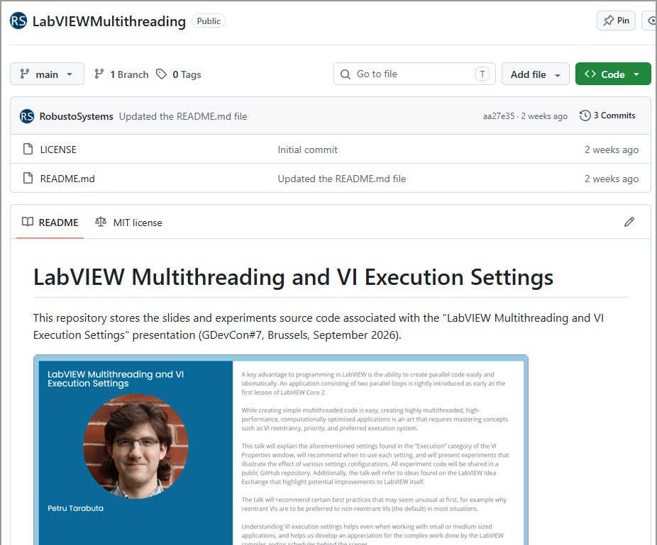
GitHub Repository
Everything related to this presentation – slides, experiment source code, experiment results – is shared in a GitHub repository that uses the permissive open-source MIT license: https://github.com/RobustoSystems/LabVIEWMultithreading
The link will be posted on Discord immediately after the presentation

Slide 8
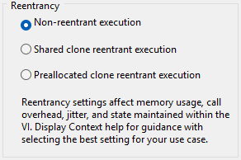
Reentrancy
Reentrancy is the most important setting to get right. It’s the setting that, in my experience, is often misconfigured.
Each LabVIEW VI can use one of three reentrancy options:
  Non-Reentrant (NR)
  Shared Clone Reentrant (SCR)
  Preallocated Clone Reentrant (PCR)
Reentrancy influences multiple execution aspects that are normally unrelated. This can make it confusing.
Deciding which setting is best for a given VI means evaluating the different effects and selecting the choice that, on balance, is the most suitable for the given VI.
Each reentrancy setting has its place. Each was created for a legitimate, useful purpose. Each setting best serves at least one use case.
The three reentrancy options. By default, new VIs use Non-Reentrant (NR).
Notes:
Without further ado, let’s enter the main part of the presentation and discuss reentrancy.

Slide 9
Non-Reentrant (NR)
Non-Reentrant is the default choice for new VIs.
In my experience, most codebases use mostly Non-Reentrant VIs. I believe this results from:
  Non-Reentrant being the default setting
  Most programmers, myself included, needing several years before starting to wonder: “What is this reentrancy setting all about? How can I make better choices in this area?”.
This presentation aims to encourage people to move away from using so many Non-reentrant VIs! Let’s see why.
The three reentrancy options. By default, new VIs use Non-Reentrant (NR).

Slide 10
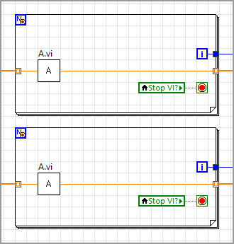
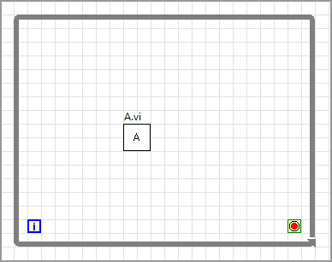
Non-Reentrant (NR)
As we know, the same VI can be called in multiple “places”. The technical term for these “places” is call sites or call locations.
Multiple call sites can reside:
  Inside the same caller VI.
  Inside different caller VIs. These caller VIs could have completely different responsibilities and could be part of completely different classes or libraries.
Call Site 1: Could be inside the main VI of a DQMH module, an AF actor, or a Worker.
Call Site 2: Could be inside the main VI of a different DQMH module, AF actor, or Worker.
Two call sites of A.vi located in different caller VIs.
Two call sites of A.vi located inside two loops of the same caller VI.

Slide 11
Non-Reentrant (NR)
Exactly one instance of a Non-Reentrant VI is stored in memory. This is the defining feature of NR VIs. NR’s pros and cons stem from it.
At any moment in time the NR instance that exists in memory is either idle (not executing) or is executing in exactly one call site. This is true regardless of how many call sites there are or how those call sites are distributed in the codebase.
Two or more code sites may need to execute the NR instance at the same time (collision). For example, a call site may wish to start executing the instance before the instance finished executing in another call site. Two instances of the same NR VI cannot exist in memory at the same time. Therefore, the second call site will wait until the NR instance finished executing in the first call site.

Slide 12
Non-Reentrant (NR)
This example demonstrates that:
  Call sites may have to wait on one another. (Collision Overhead)
    This reduces app performance, but only when a collision occurs (when two or more call sites try to run the NR VI at the same time).
  LabVIEW must use a co-ordination mechanism that ensures the second call site waits until the NR instance is free to run again. This mechanism executes each time the NR instance is called. It adds a computational overhead (Co-ordination Overhead) to each call of the NR VI, regardless of whether collisions are occurring or not.
    Technical details: LabVIEW must maintain a data structure for each NR VI. When a call site starts executing, LabVIEW updates the data structure to record that the instance is busy. When the call site finishes executing, LabVIEW updates the data structure to record that the instance is free to run again. This is the basic implementation of a mutex (mutual exclusion) lock.
    The co-ordination mechanism reduces app performance further.

Slide 13


Non-Reentrant (NR) – Analogy
Lord Of The Flies film (1963, 1990, 2026)
Notes:
NR VIs may need to wait on one another. An analogy is how, in the classic Lord Of The Flies film, the boys stranded on an island decide that, when they stand in a circle, only the boy that has the conch (a sea shell) can speak. A boy needs to pass the conch to another boy for the other boy to speak. This is analogous to the co-ordination mechanism that LabVIEW executes behind the scenes.
IMDB film URL: https://www.imdb.com/title/tt0057261

Slide 14
Non-Reentrant (NR)
Collision Overhead: call sites wait on each other
Call Site 1
VI Code
VI Code
wait
Call Site 2
VI Code
Co-ordination Overhead (mutex)
Moment call site 2 wishes to start running the NR VI
Moment call site 2 is given permission to start running the NR VI
Time
In my experience most programmers are aware of the Collision Overhead but are unaware of the Co-ordination Overhead.
The Collision Overhead can be the most dangerous. It can lead to noticeably sluggish behaviour and bugs. This is especially true if the VI takes more than a few hundred milliseconds to execute and its call sites run in parallel loops (lots of collisions).
  However, collisions don’t necessarily happen on each call. Apps can use lots of NR VIs and still experience a low number of or even zero collisions.
The Co-ordination Overhead is small per VI call but significant in aggregate. This overhead occurs on each and every call to a Non-Reentrant VI.
We need to get rid of the overheads to achieve better performance.
Notes:
This diagram illustrates the two types of overhead associated with Non-Reentrant (NR) VIs.

Slide 15
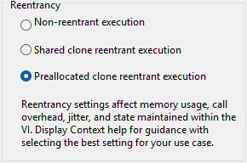
Preallocated Clone Reentrant (PCR)
Preallocated Clone Reentrant (PCR) is the option that eliminates the overheads.
When using PCR LabVIEW creates a memory instance for each call site. If a VI is called n times in a codebase, LabVIEW allocates exactly n memory instances.
Memory instances are also known as clones. This is what Clone refers to.
Two or more instances (clones) can run at the same time (don’t wait on one another). This is what Reentrant refers to.
LabVIEW allocates the memory instances (the clones) during VI compilation, before the VI starts running. This is what Preallocated refers to.
The Preallocated Clone Reentrant (PCR) option.

Slide 16
Preallocated Clone Reentrant (PCR)
Because each call site has its own memory instance, each call site can execute fully independently of all other call sites.
No co-ordination mechanism exists (not needed).
Each call site doesn’t “know” or “care” about other call sites. This is good – it’s a must for truly independent execution. Any form of co-ordination between the call sites means that execution is pseudo-independent.
PCR is the only option that implements full parallelism.
Because no co-ordination mechanism exists, PCR is the most deterministic option. It achieves the best (lowest) jitter. Best for real-time applications.
Because multiple instances exist in memory, PCR makes a codebase use (slightly) more memory than using NR. This is usually nothing to worry about (more on this later).
The Preallocated Clone Reentrant (PCR) option.

Slide 17
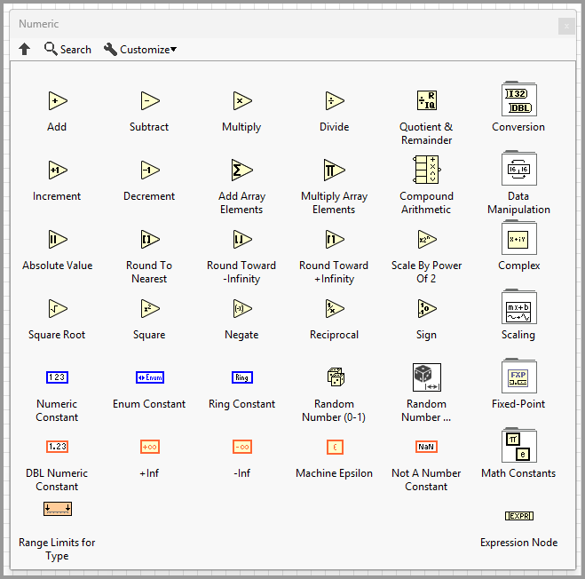
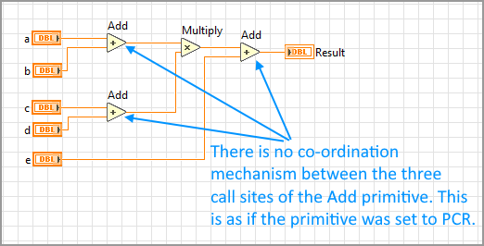
Preallocated Clone Reentrant (PCR)
What other functions that we know and love execute in a similar way (each call side doesn’t know or care about other call sites)?
  The primitive functions. Most primitives (perhaps all) behave like PCR VIs. Primitives correctly execute totally independently of one another.
  Each Add primitive executes fully independently of any other Add primitives that may exist in the codebase.

Slide 18
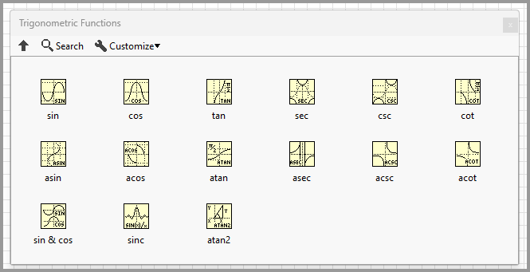
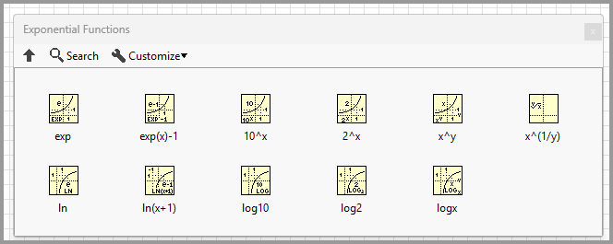
Preallocated Clone Reentrant (PCR)
The same is true of most (perhaps all) primitives.
PCR is the option that makes our VIs behave more like language primitives. This is desirable.

Slide 19
Diagram 1: Execution when A.vi is Non-Reentrant
Overhead Type 1: call sites waiting on each other
Call Site 1
VI Code
VI Code
wait
Call Site 2
VI Code
Overhead Type 2: co-ordination mechanism (mutex)
Moment call site 2 wishes to start running the NR VI
Moment call site 2 is given permission to start running the NR VI
Time
Diagram 2: Execution when A.vi is Preallocated Clone Reentrant
The overheads were eliminated.
Call Site 1 starts the second run sooner.
Call Site 2 starts its run sooner.
Call Site 1
VI Code
VI Code
Call Site 2
VI Code
Time
Notes:
Let’s revisit the execution diagram. This slide compares Diagram 1 (A.vi is set to NR) with Diagram 2 (A.vi is set to PCR). Diagram 2 illustrates a much more performant situation.

Slide 20

Preallocated Clone Reentrant (PCR) – Analogy

Slide 21
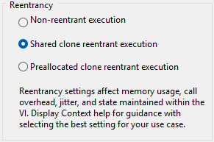
Shared Clone Reentrant (SCR)
Shared Clone Reentrant (SCR) eliminates the Collision Overhead but maintains a Co-ordination Overhead.
When an SCR VI is used in n call sites, LabVIEW uses a pool of memory instances that contains between 1 and n instances.
The same memory instance may be used (shared) by two or more call sites, if those call sites don’t execute at the same time (execution doesn’t overlap). This is what “Shared” refers to.
LabVIEW actively manages the size of the pool by spawning new instances and closing old instances. This mechanism accounts for the Co-ordination Overhead. This mechanism is different than the NR mutex mechanism, so the execution overhead is different (could be smaller or larger).
The Shared Clone Reentrant (SCR) option.
Notes:
Ok, we’ve discussed Non-Reentrant and Preallocated Clone Reentrant. How about Shared Clone Reentrant?

Slide 22
Shared Clone Reentrant (SCR)
SCR can reduce memory usage.
Let a codebase contain 20 call sites of a VI. Let the codebase function in such a way that a maximum of 3 call sites execute at the same time. All 20 call sites are used, but a maximum of 3 are used at the same time. If the VI is set to PCR, 100 instances will exist in memory. If the VI is set to SCR, a maximum of 3 instances will exist in memory. The 3 instances are sufficient to service all call sites while avoiding collisions. Thus, a reduction of 17 memory instances.
When a call site starts running LabVIEW needs to check if a memory instance is available. If no instance is free, LabVIEW needs to spawn a new instance on-the-fly. This is non-deterministic, can increase jitter.
The Shared Clone Reentrant (SCR) option.

Slide 23
Shared Clone Reentrant (SCR)
SCR is correctly located between NR and PCR. It borrows characteristics from NR (co-ordination overhead, smaller memory usage) and from PCR (parallel execution, no waiting for another call site to finish).
Just being “in the middle” doesn’t automatically make it the best default, or the best choice for most VIs.
The Shared Clone Reentrant (SCR) option.

Slide 24
Taking a step back
The reentrancy option dictates the relationship between a VI’s call sites and its memory instances. All characteristics of each option derive from the call sites-to-memory instances relationship.
Reentrancy | Number of Call Sites | Number of Memory Instances
NR | N | 1
SCR | N | 1 to N (actively managed)
PCR | N | N

Slide 25
NR vs SCR vs PCR
 | CS | MI | Pros | Cons
NR | N | 1 | Lowest memory usage Can be used to implement FGVs or Action Engines* | Collision and co-ordination overhead (mutex) Sequential, anti-parallel execution Fights against LabVIEW’s parallel nature High jitter. Not best for real-time applications. Adds invisible ties (the co-ordination mechanism) between different regions of code. Bad from a software engineering, clean code perspective.***
SCR | N | 1..N | Lower memory usage than PCR Enables parallel execution Required to implement recursion** Only form of parallelism supported by Dynamic Dispatch VIs | Co-ordination overhead (pool management) High jitter. Not best for real-time applications. Adds invisible ties (the co-ordination mechanism) between different regions of code. Bad from a software engineering, clean code perspective.***
PCR | N | N | No overheads compared to NR and SCR Truly parallel, independent execution Most alike the primitive functions Most deterministic, lowest jitter. Best for real-time applications. Best from SE/clean-code perspective | Highest memory usage
CS = Number of Call Sites, MI = Number of Memory Instances.
*FGVs and Action Engines (AEs), while popular in older codebases, are largely superseded by better communication and data sharing mechanisms in modern frameworks. I personally very rarely create FGVs or AEs nowadays.
**Recursive algorithms, while fun to play with, often take longer to execute and use more memory than the same algorithm implemented in the traditional, iterative fashion. All recursive algorithms can be implemented iteratively and vice-versa.
***Example: Imagine a codebase that uses a native non-reentrant VI in a tight loop inside module M1. The code works fine.
Later, the codebase grows and a new module, M2, starts using an open-source, third-party library
that also happens to call the same native non-reentrant VI. The tight loop in M1 might start to work differently.
This is dangerous. Adding new code makes existing code behave differently. Not good from an SE perspective.

Slide 26
NR vs SCR vs PCR
Performance
Memory usage
Non-Reentrant
Shared
Clone
Reentrant
Preallocated Clone Reentrant
We get better and better performance by moving from NR to SCR to PCR. We also use more and more memory. This is ok. This simply means that we are making use of the machine’s memory towards achieving parallel execution. We are putting memory to work to achieve best performance. Nowadays PCs and even embedded devices have lots of memory.
Anecdotally, memory usage is relatively low even when a codebase uses lots of PCR VIs. I will provide two data points shortly.

Slide 27
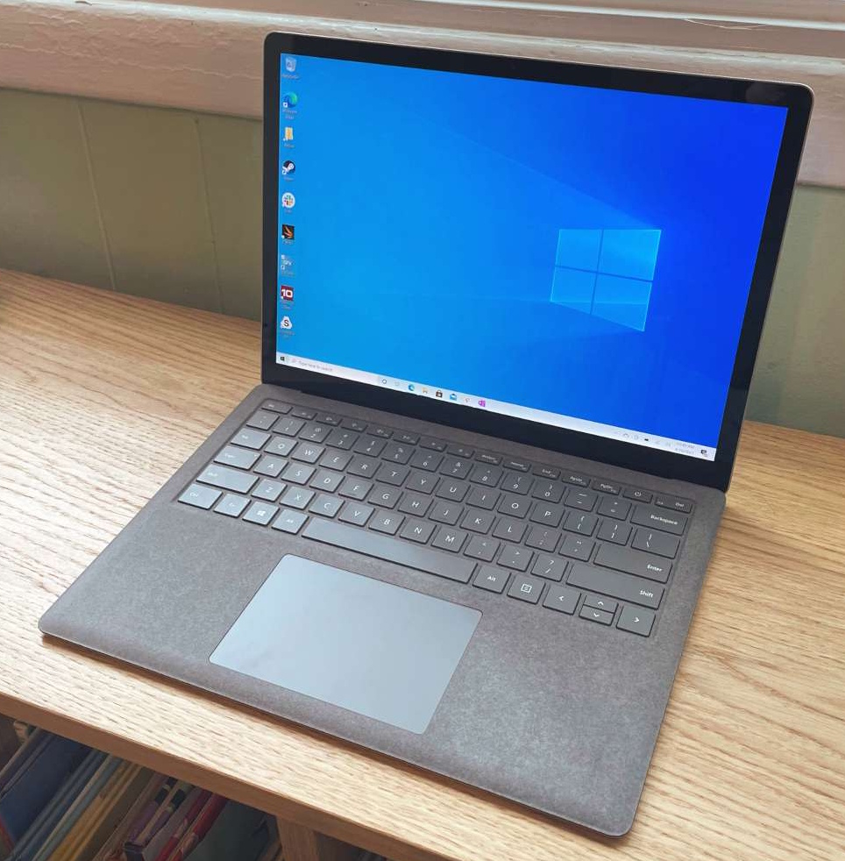
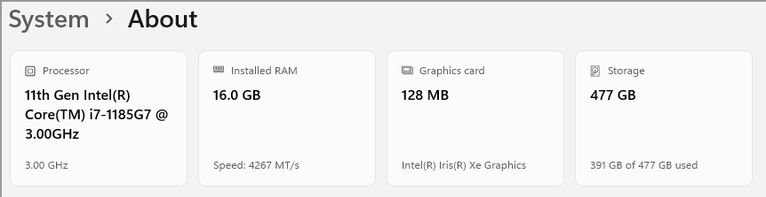
Experiments
Let’s see some experiments that shed light on the performance difference.
All experiments were run in the latest LabVIEW version – LabVIEW 2026 Q3 Patch 1 (26.3.1f1) (64-bit) – on Windows 11.
All experiments were run on the laptop I’m presenting from (model name: Surface Laptop 4).

Slide 28
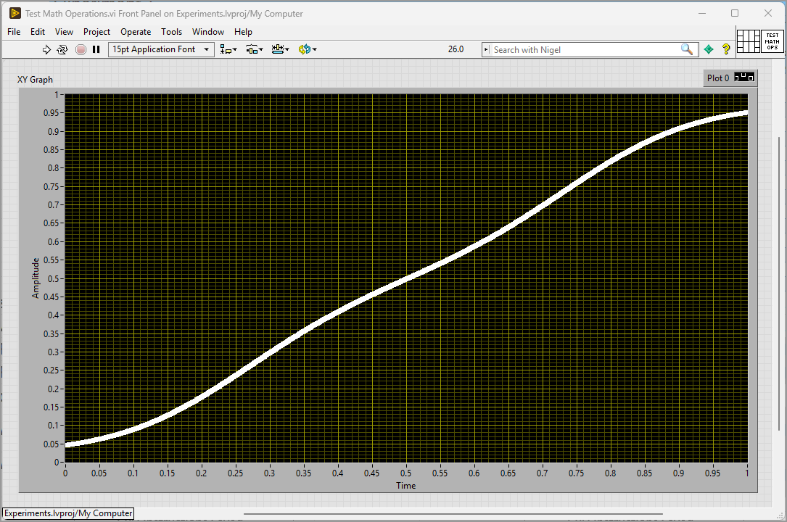
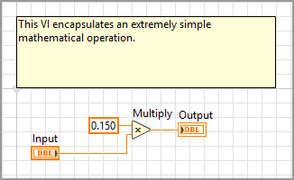
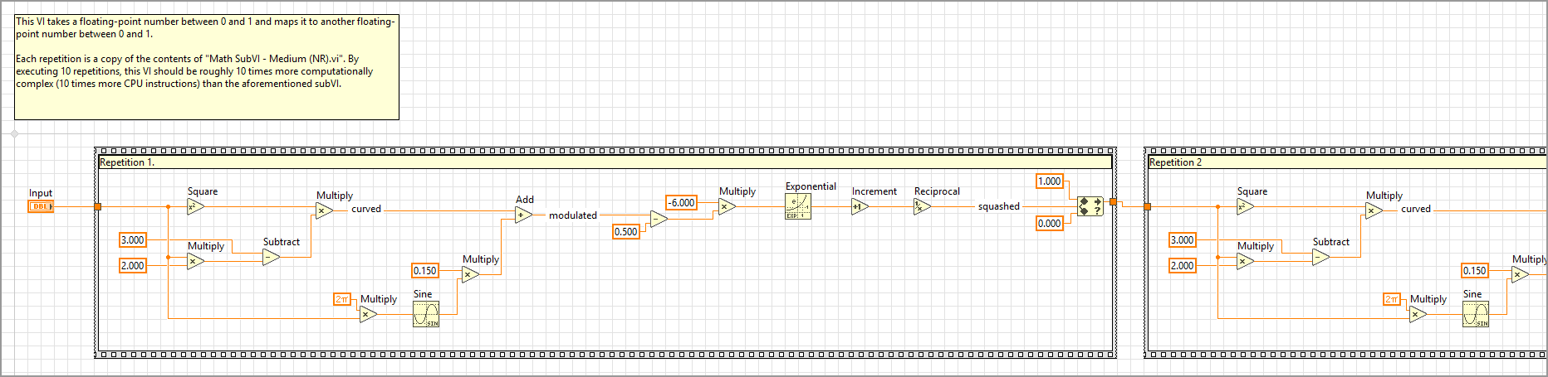
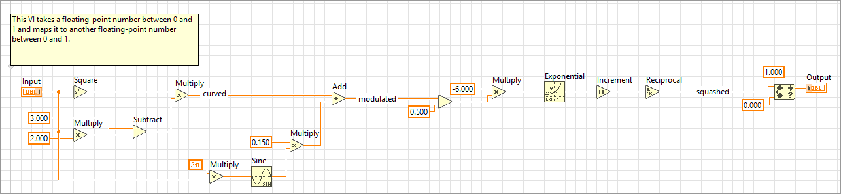
Experiments
Three mathematical subVIs were created
  Low Complexity VI (a.k.a. Simple VI)
  Moderate Complexity VI (a.k.a. Medium VI)
  High Complexity VI (a.k.a. Complex) = 10 repetitions of the code of the Medium VI
Each subVI has one DBL input and one DBL output
The subVIs can be chained together
Multiple versions of each subVI were created: NR, SCR, PCR. Execution settings were the only difference (no block diagram changes).

Slide 29
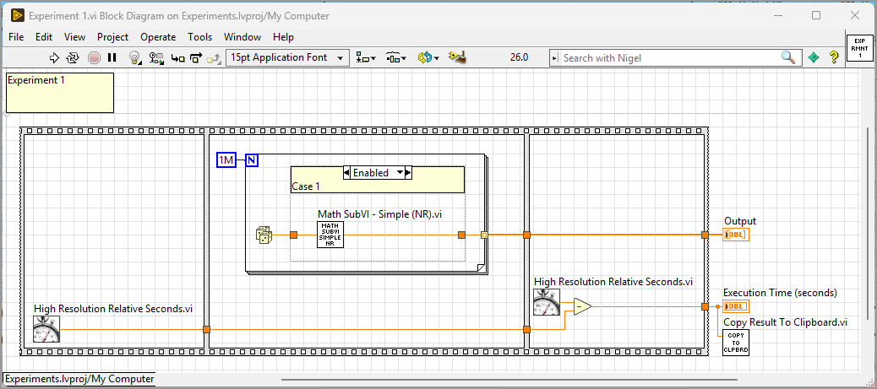
Experiments
Caller VIs named Experiment 1.vi, Experiment 2.vi, Experiment 3.vi, etc., were created
  Each Experiment VI is a simple caller of one or more of the subVIs.
  Each Experiment VI benchmarks the execution time using High Resolution Relative Seconds.vi
  Experiment VIs contain Diagram Disable Structures (DDS). Each case contains a different version of a subVI.
  Experiments were run as follows:
    A DDS case would be enabled
    The Experiment VI would be run a set of 5 times, 10 times, or 15 times
    The results of each run were recorded in an Excel spreadsheet
    Another DDS case would be enabled, and the process repeated

Slide 30
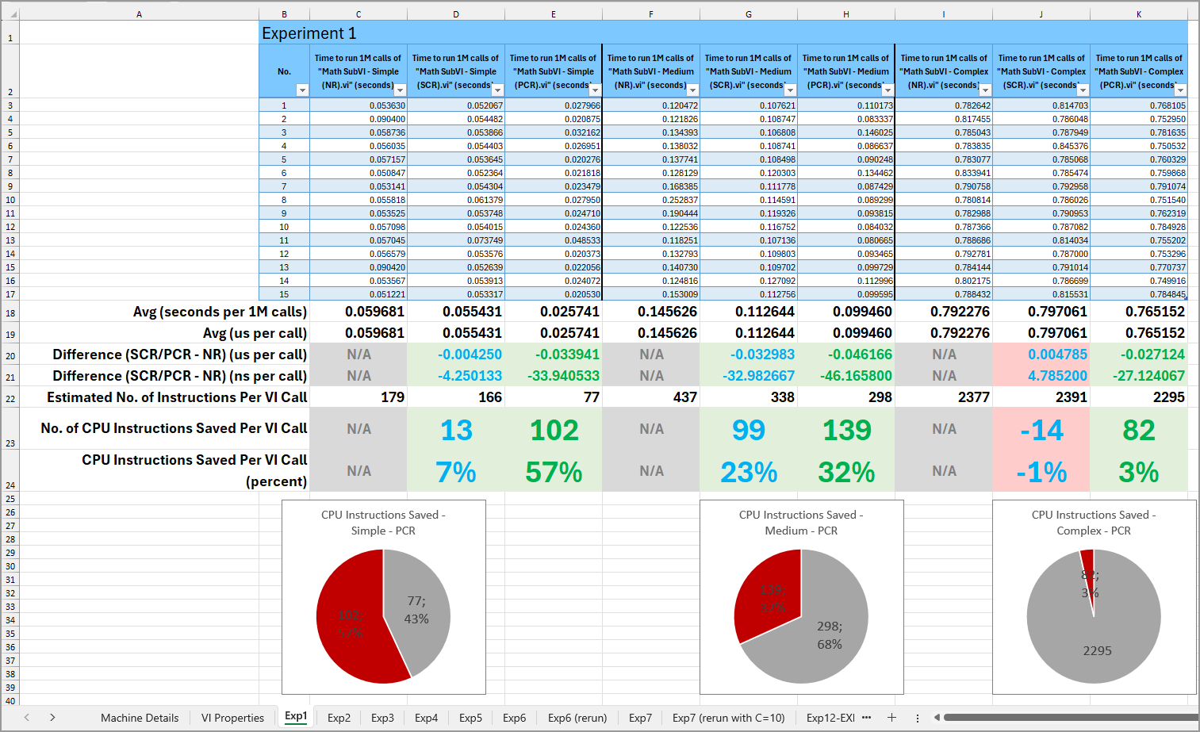
Experiments
Results were collected and analysed in Experiment Records.xlsx

Slide 31
Experiment 1

Slide 32
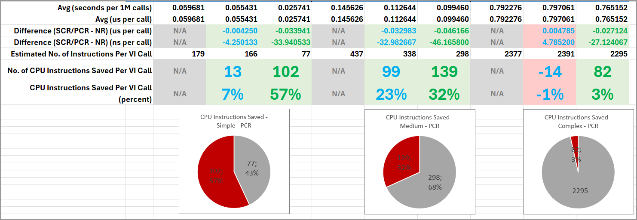
Experiment 1 Results
Notes:
Verbally explain:
The simple VI was 7% more performant when using SCR than NR. And was 57% more performant when using PCR than NR.
The medium-complexity VI was 23% more performant when using SCR than NR. And was 32% more performant when using PCR than NR.
The high-complexity VI was slightly less performant (-1%) when using SCR than NR. And was 3% more performant when using PCR than NR.
Each pie chart highlights the overhead that NR has compared to PCR. The red part is the NR overhead.

Slide 33
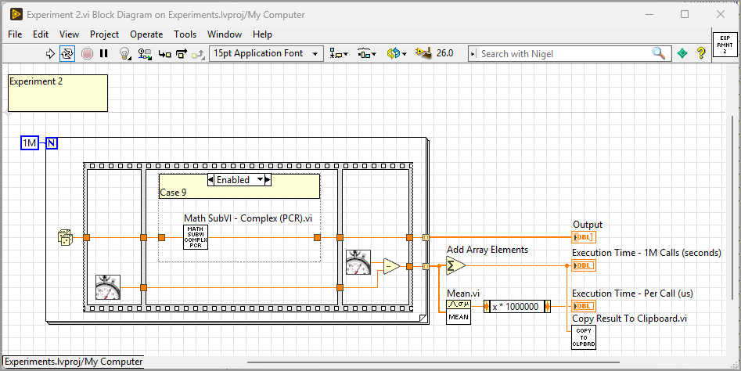
Experiment 2
Notes:
Verbally explain:
In Experiment 2 the location of the two High Resolution Relative Seconds.vi was changed. They are inside the loop.

Slide 34
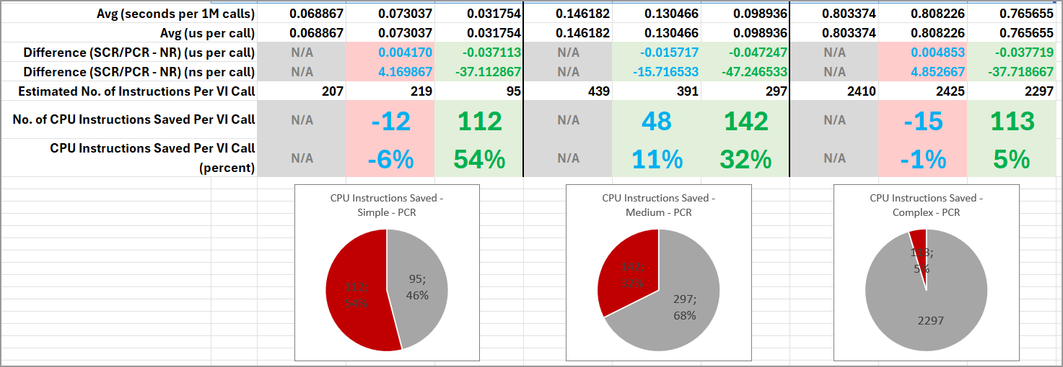
Experiment 2 Results
Notes:
Verbally explain:
The simple VI was less performant when using SCR than NR (-6%). And was 54% more performant when using PCR than NR.
The medium-complexity VI was 11% more performant when using SCR than NR. And was 32% more performant when using PCR than NR.
The high-complexity VI was slightly less performant (-1%) when using SCR than NR. And was 5% more performant when using PCR than NR.

Slide 35
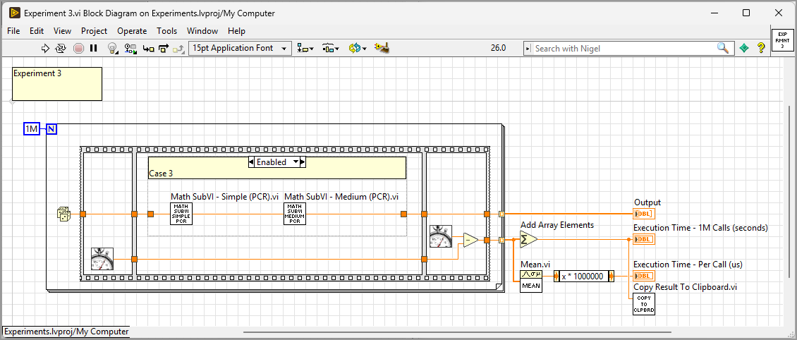
Experiment 3
Notes:
Verbally explain:
In Experiment 3 two VI calls are chained together inside each for loop iteration.

Slide 36
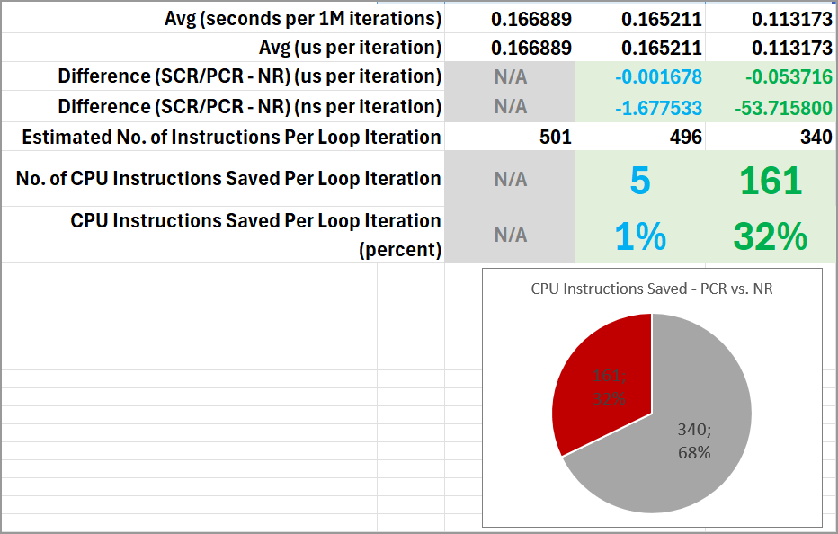
Experiment 3 Results
Notes:
Verbally explain:
SCR + SCR chain had basically no performance difference over NR + NR chain (1%).
PCR + PCR chain had 32% performance improvement over NR + NR chain.

Slide 37
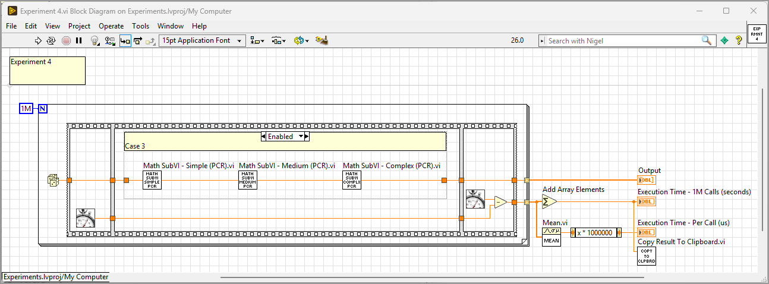
Experiment 4
Notes:
Verbally explain:
In Experiment 4 all three subVIs were chained together inside each for loop iteration.

Slide 38
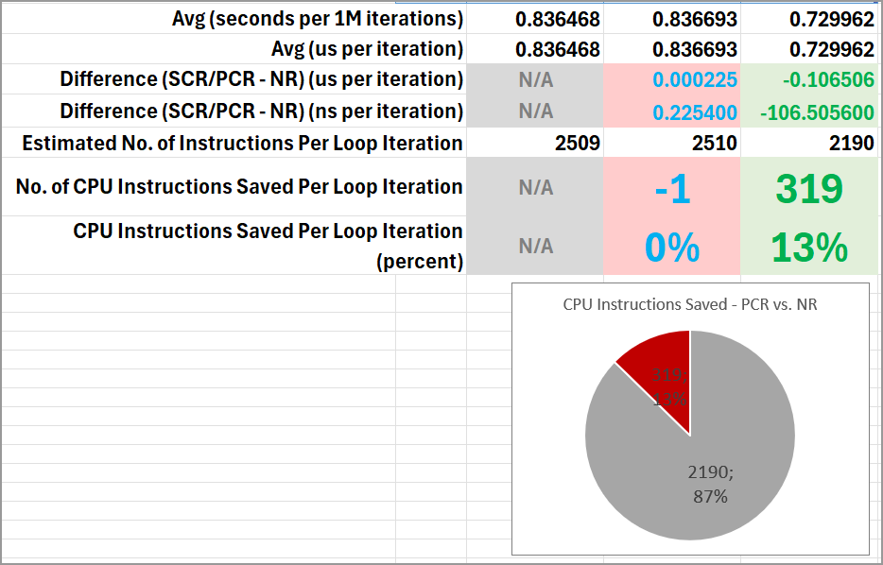
Experiment 4 Results
Notes:
Verbally explain:
SCR + SCR chain had basically no performance difference over NR + NR chain (-1%).
PCR + PCR chain had 13% performance improvement over NR + NR chain.
This is to be expected. The complex VI was added to the chain. The overhead computations are smaller w.r.t. the actual computations performed inside the VIs.

Slide 39
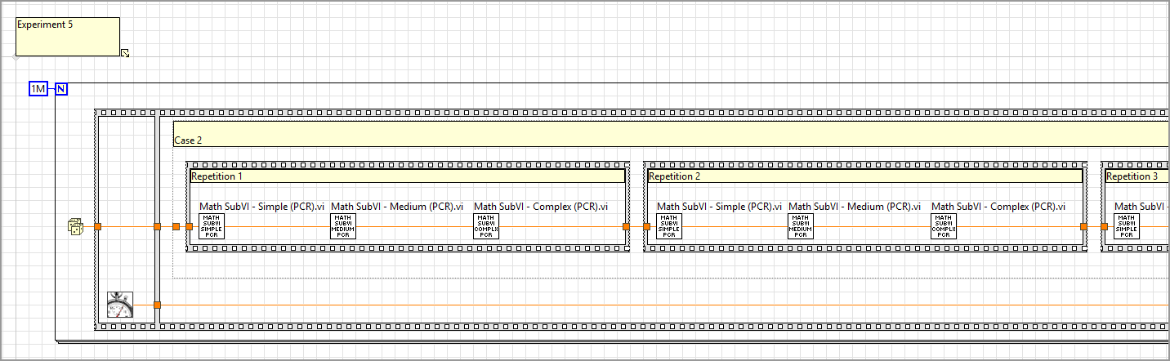
Experiment 5
Notes:
Verbally explain:
In Experiment 5 we repeated the chain of three subVIs 5 times. Each loop iteration contained 15 subVI calls (3 x 5).

Slide 40
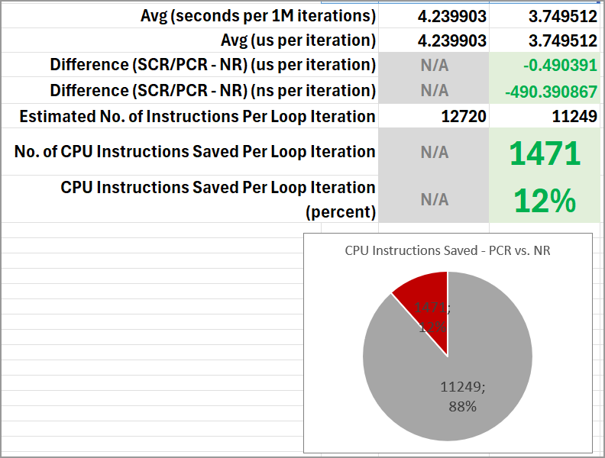
Experiment 5 Results
Notes:
Verbally explain:
This experiment tested only a chain of NR VI calls vs. chain of PCR calls. SCR calls were not tested in this experiment.
Chain of 15 PCR VI calls had 12% performance improvement over chain of 15 NR calls.
Very similar result to that of Experiment 4. This is as expected.

Slide 41
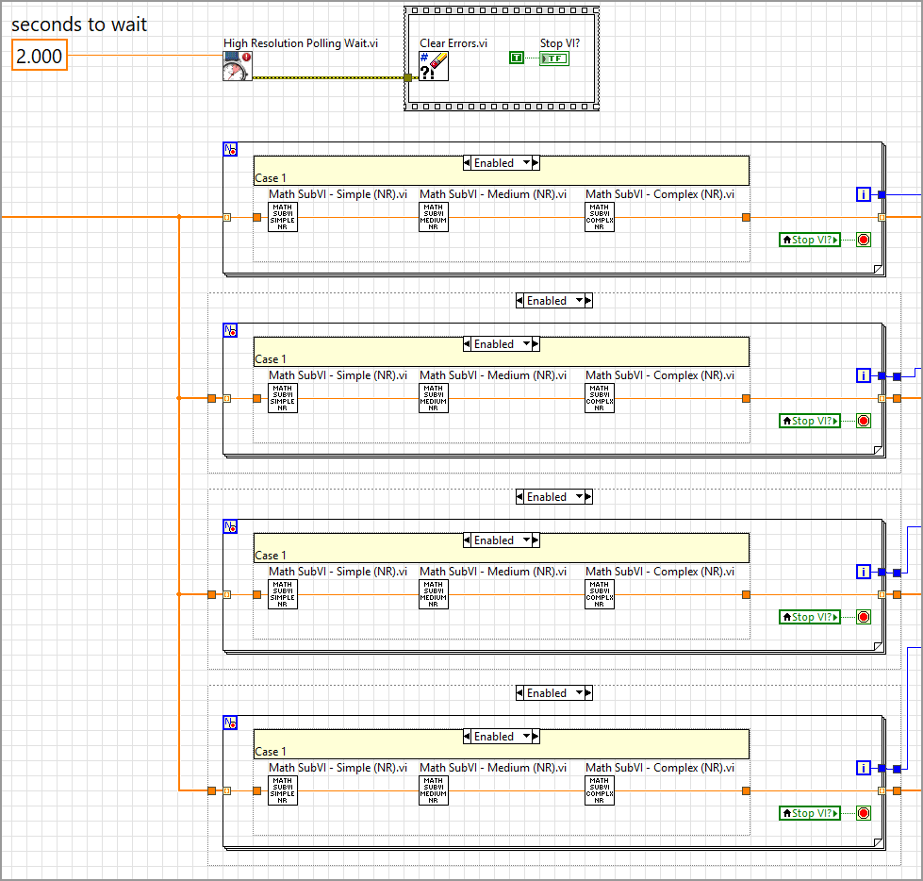
Experiment 7
Notes:
Verbally explain:
We are skipping Experiment 6 for now, jumping to Experiment 7.
This experiment is the first one to test performance of parallel loops.
Each loop contains a chain of three VIs: either all set to NR, all set to SCR, or all set to PCR
Loops 2, 3, and 4 are placed inside Diagram Disable Structures. This enabled running the experiment with 1 loop, 2 parallel loops, and all 4 parallel loops, and compare results.

Slide 42
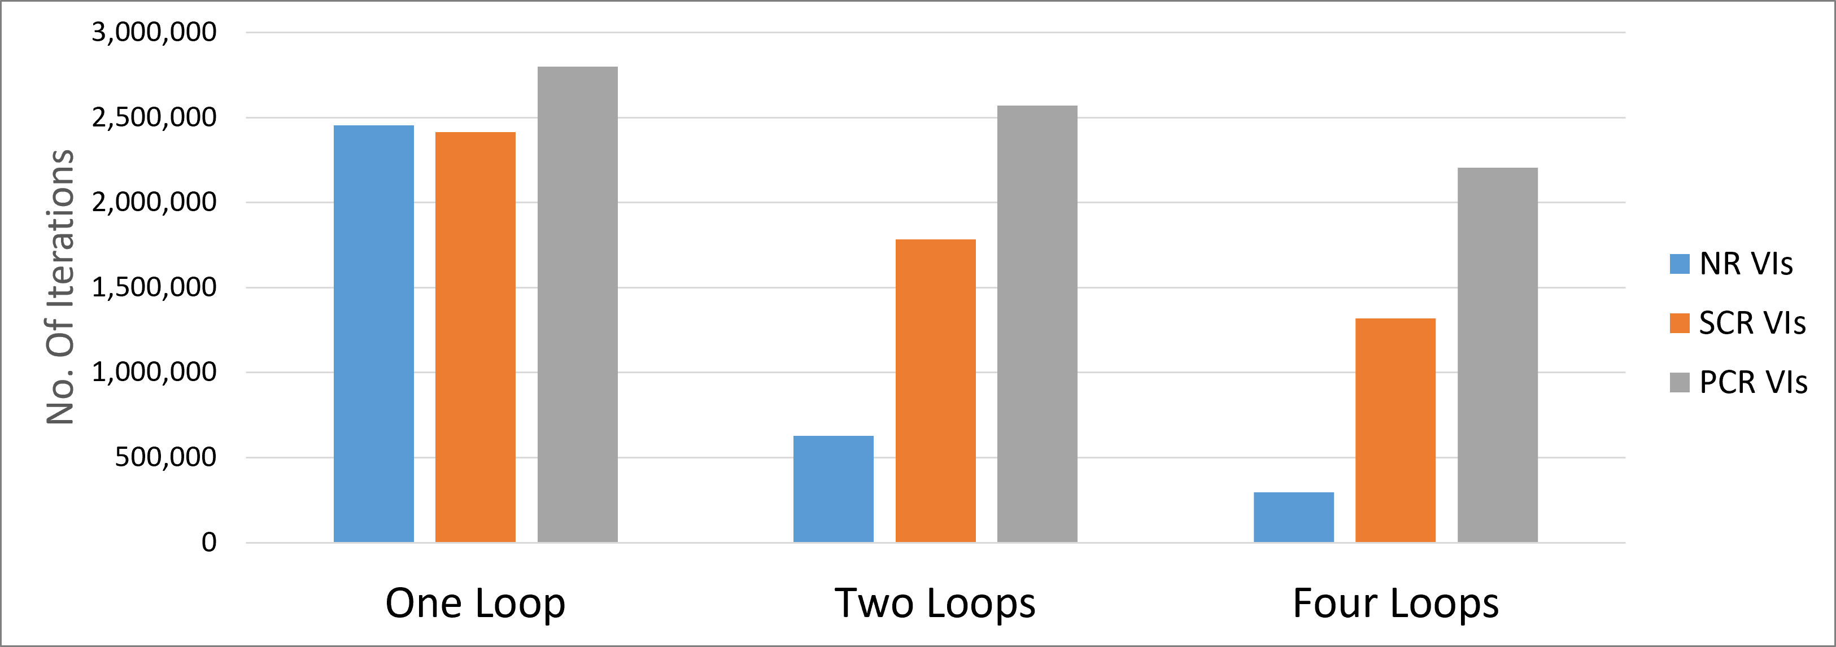
Experiment 7 Results
Notes:
Verbally explain:
This experiment shows that:
The performance of NR VIs goes down dramatically from 1 to 2 to 4 parallel loops. This is because more and more collisions start occurring. The collision overhead is starting to show.
The performance of SCR VIs is much better than NR VIs.
The performance of PCR VIs is much better still than SCR VIs.
The maximum number of iterations that each loop achieves slightly decreases when more and more parallel loops are added. This is as expected.

Slide 43
Recommendations
We’ve seen PCR consistently and significantly outperform NR and SCR.
PCR is the setting I choose for most VIs I create (where the PCR setting is available).
  Dynamic Dispatch VIs (including dynamic class accessors) cannot use PCR.
Give Preallocated Clone Reentrant a try. You will be pleasantly surprised.
The Preallocated Clone Reentrant (PCR) option.

Slide 44
Common objections
Objection 1: My codebase will use too much memory if I use many PCR VIs
  Example 1 (personal experience):
    Large Windows app. Contains around 10,000 VIs. Organised in dozens of DQMH modules, many other classes and libraries.
    Many of the DQMH modules contain complex user-facing GUIs (front panels)
    The app acts as a hub at the centre of a networked system. App can form and send more than 2,000 heterogenous TCP messages per second. It can receive and parse more than 2,000 heterogenous TCP messages per second.
    Uses around 820 MB of memory (Private Bytes)
    The app runs on a dedicated Windows 11 workstation with 16 GB of memory.
      820 MB is small compared to the available 16 GB.
  Example 2 (personal experience):
    Set of seven different cRIO apps. Each containing around 1,000 VIs organised in several DQMH modules, as well as several classes and libraries.
    Each of them acquires analogue and digital channels using DAQmx and control outputs via FPGA I/O nodes.
    Each of them can send up to 200 TCP messages per second to the Windows app.
    Each of them uses around 30% of the memory available in cRIO-9045.
Notes:
In the past couple of years, when I mentioned my preference towards PCR to colleagues, I got a few common concerns or objections.

Slide 45
Common objections
Objection 2: PCR VIs are hard to debug
  Probes and breakpoints are fully supported in PCR VIs. Placing probes and breakpoints is not harder at all.
  PCR VIs are the simplest to reason about. The call site being debugged is independent of all other call sites. You can rest assured that no other call sites affect the instance you are debugging.
Objection 3: PCR VIs sometimes look “weird”
  When opening a clone VI from the diagram of a caller VI, the clone VI sometimes opens in Run mode.
  Press Ctrl + M to bring it back to edit mode (to edit the master blueprint for all call sites)
Objection 4: But I don’t need all this performance anyway
  I agree that many LabVIEW applications are not actively limited by the computational overhead that NR and SCR VIs add. Proof of this are the many LabVIEW applications in which NR VIs dominate. These apps do not suffer bugs and do not experience human-noticeable delays due to NR VIs.
  Use PCR because it’s better from a Software Engineering (clean code) point of view, even if performance is not your priority.
  Use PCR because it’s the setting that works with (not against) LabVIEW’s parallel nature

Slide 46
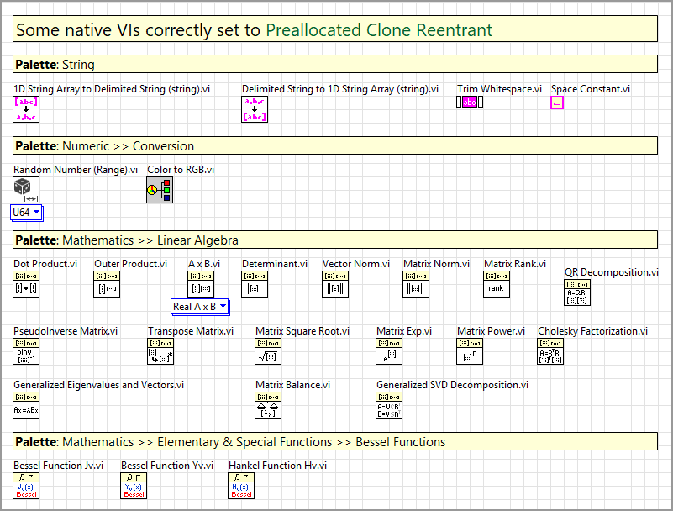
PCR Usage In Well-Known VIs
Ok, if PCR is so great, do any VIs I know use it?
  Yes, lots of native VIs are correctly set to PCR. Native VIs = VIs that ship with LabVIEW. Most are located in vi.lib.
Notes:
This is a very small subset of the native VIs that are correctly set to PCR. There are many more native VIs correctly set to PCR.

Slide 47
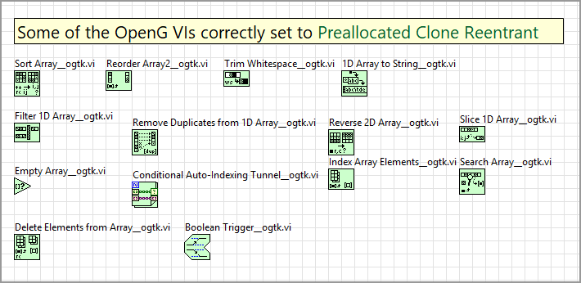
PCR Usage In Well-Known VIs
Lots of popular OpenG VIs correctly use PCR
Notes:
This is a subset of the popular OpenG VIs that are correctly set to PCR.

Slide 48
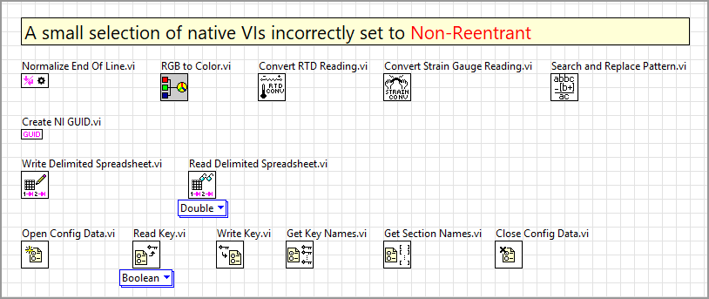
LabVIEW Ideas
Unfortunately, there are lots of native VIs that are set to Non-Reentrant. These should be set to PCR (or SCR where PCR is not available).
Notes:
The fact that these native VIs are non-reentrant means that:
1. Unnecesary overhead is being spent by our LabVIEW apps on co-ordinating the sequential execution of these small VIs.
2. Tight-loop, parallel execution of VIs that use any of these VIs as subVIs is severely limited.

Slide 49
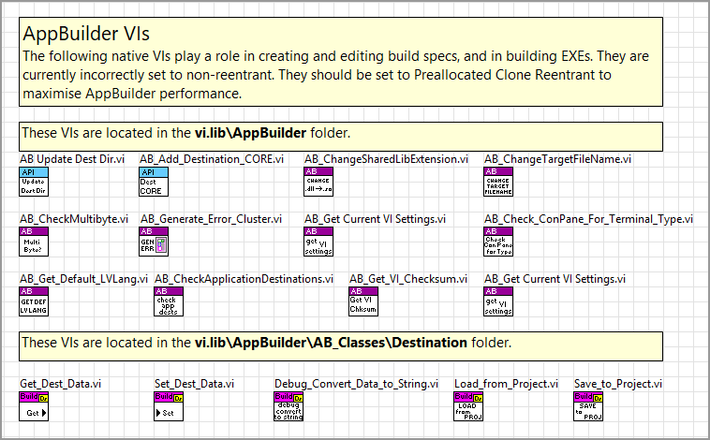
LabVIEW Ideas
Unfortunately, there are lots of native VIs that are set to Non-Reentrant. These should be set to PCR (or SCR where PCR is not available).
Notes:
These are VIs that exist in the AppBuilder folder. Setting these VIs to PCR would improve the performance of creating/editing build specs and building EXEs.

Slide 50
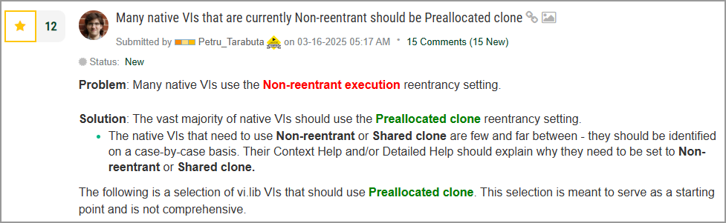
LabVIEW Ideas
This idea asks for more native VIs to be set to PCR: https://forums.ni.com/t5/LabVIEW-Idea-Exchange/Many-native-VIs-that-are-currently-Non-reentrant-should-be/idi-p/4429431
This idea requests that, by default, new VIs should come already set to PCR (not to NR): https://forums.ni.com/t5/LabVIEW-Idea-Exchange/The-reentrancy-of-new-VIs-should-be-quot-Preallocated-clone-quot/idi-p/4429369
  Currently the default new VI type (NR) fights against LabVIEW’s parallel nature. PCR works in service of it.

Slide 51
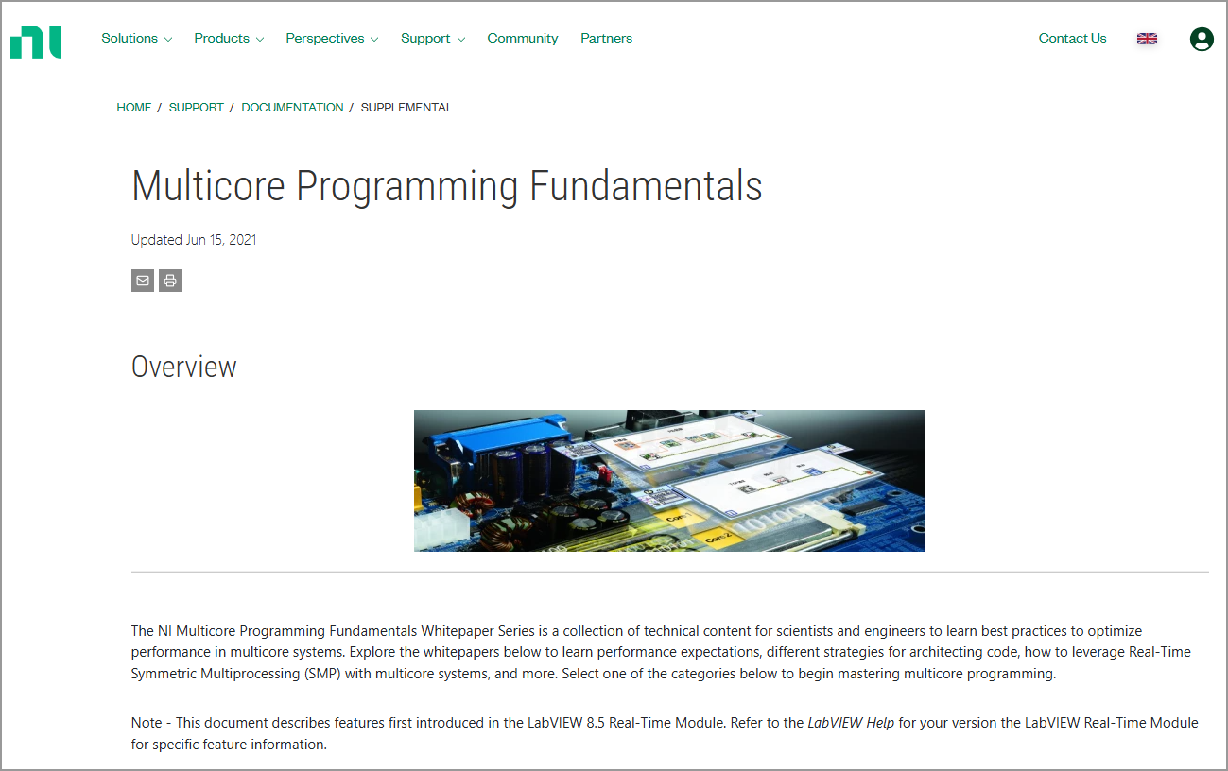
Multicore Programming Fundamentals Whitepaper Series
There is a useful whitepaper series named “Multicore Programming Fundamentals”: https://www.ni.com/en/support/documentation/supplemental/07/multicore-programming-fundamentals.html

Slide 52
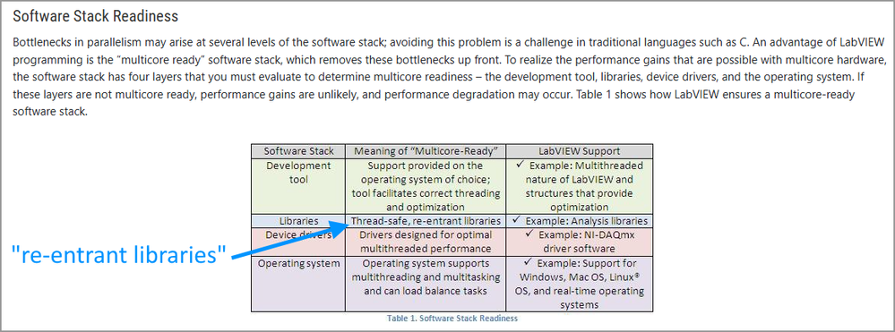
Multicore Programming Fundamentals Whitepaper Series
The Will My LabVIEW Programs Run Faster When I Upgrade to a Multicore Computer? whitepaper mentions that one of the reasons LabVIEW is multicore-ready is that it has re-entrant libraries, and correctly gives mathematical analysis libraries as an example of libraries that contain reentrant VIs.
This is NI correctly priding itself with the native re-entrant VIs that exist in LabVIEW. The logical follow-up is to make more native VIs reentrant and to make the default new VI reentrant.

Slide 53
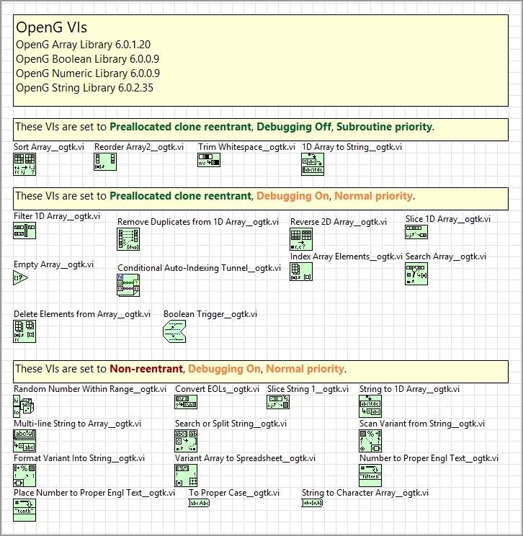
OpenG VIs set to Non-Reentrant
Some of the popular OpenG VIs are also set to Non-Reentrant.
  This is not a criticism. I have tremendous respect and admiration for the OpenG VIs and the people that created them. These VIs have been extremely useful to so many developers for so many years.
Notes:
I have tremendous respect and admiration for the OpenG VIs and the people that created them. They have been extremely useful to so many developers for so many years.

Slide 54
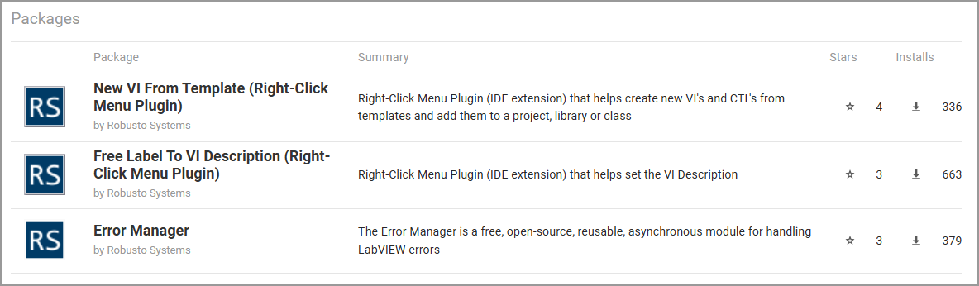
Mea Culpa – Robusto Systems VIPM packages
I published these free, open-source packages around 3 years ago, which is before I became fully aware of everything that was discussed so far. These packages use lots of NR VIs. I aim to release new versions soon that will use the PCR setting more and will be more performant.

Slide 55
Constructive Feedback
None of these ideas are criticisms. They are all constructive feedback.
We learned from Tony Vento’s excellent presentation yesterday that we need to be like Alice in Wonderland and call out nonsense if we see it. These ideas do that.
I love LabVIEW, I use it virtually every day, I built a career on it. I want LabVIEW to be better so I can be better.
Notes:
We learned from Tony Vento’s presentation yesterday that we need to be like Alice in Wonderland and call out nonsense if we see it.

Slide 56
Subroutine and Inline
Notes:
Let’s discuss subroutine and inline, if time allows.

Slide 57
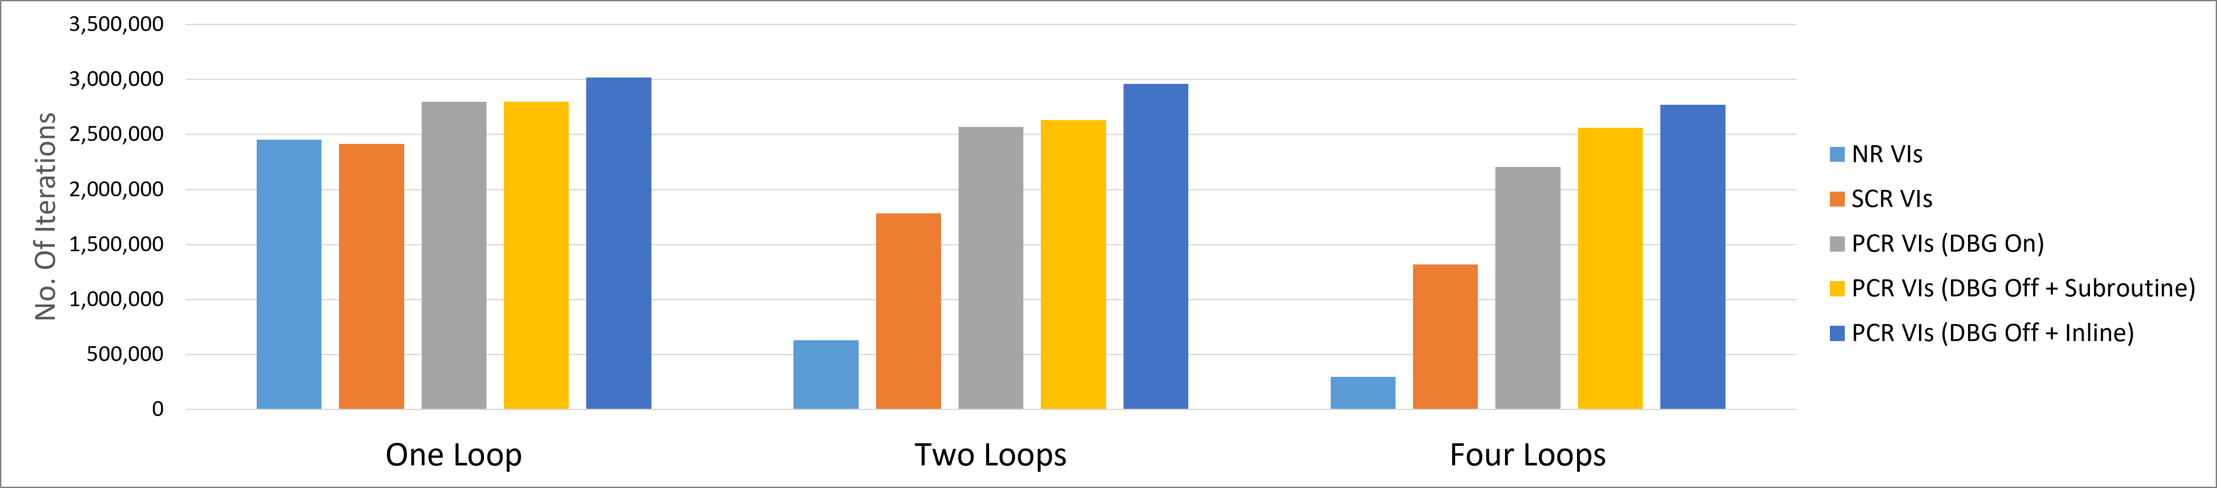
Subroutine and Inline
Notes:
Enabling subroutine on PCR VIs increases performance further. Enabling inline increases performance even further.

Slide 58
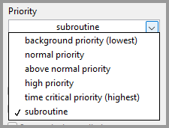
Subroutine and Inline
Many PCR VIs can and should be set to subroutine
The subroutine priority is conceptually very different than the other five priorities
“Select subroutine priority to make the LabVIEW execution system run the VI as efficiently as possible.“ (source : this LabVIEW help page)
The subroutine priority reduces VI call overhead further
Code inside a subroutine executes in the same thread as its caller VI.
The LabVIEW scheduler has less work to do (fewer decision points)
Best for small, “pure” VIs
Notes:
Enabling subroutine on PCR VIs increases performance further. Enabling inline increases performance even further.
By “pure” VIs we mean VIs that take one or more inputs, perform computations on those input values, and produce one or more output values. Such VIs do not read/write global variables or FGVs, do not send or receive asynchronous messages (queues, notifiers, events), do not control hardware, do not perform file I/O, do not send network messages.

Slide 59
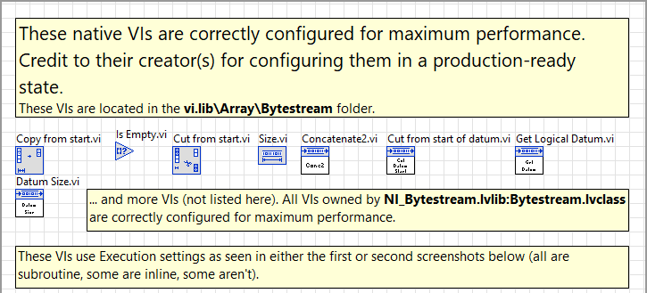
Subroutine and Inline
Many native VIs correctly use subroutine
The following is a small subset
This idea requests that even more native VIs are set to subroutine: https://forums.ni.com/t5/LabVIEW-Idea-Exchange/Performance-improvement-More-native-VIs-should-be-set-to/idi-p/4485882

Slide 60
Subroutine and Inline
The recommended execution settings to achieve maximum performance while avoiding IDE slowdown. Recommended for most small, “pure” VIs, including low-level reusable VIs.
Notes:
Enabling subroutine on PCR VIs increases performance further. Enabling inline increases performance even further.

Slide 61
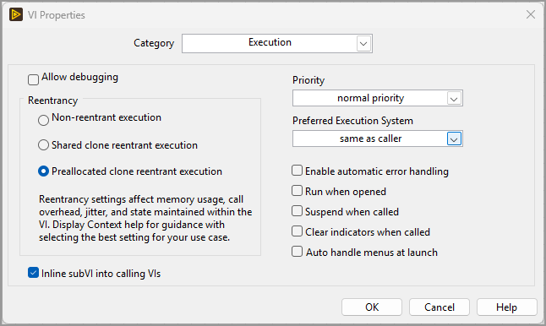
Subroutine and Inline
The execution settings to achieve maximum performance. When lots of VIs are inlined you may experience IDE slowdown, sluggish behaviour when creating new wires, deleting wires, etc.
Notes:
Enabling subroutine on PCR VIs increases performance further. Enabling inline increases performance even further.

Slide 62
Resources (part 1)
No. | Resource Name | URL
1 | This presentation and associated files | https://github.com/RobustoSystems/LabVIEWMultithreading
2 | Multicore Programming Fundamentals (NI Whitepaper Series) | https://www.ni.com/en/support/documentation/supplemental/07/multicore-programming-fundamentals.html
3 | Will My LabVIEW Programs Run Faster When I Upgrade to a Multicore Computer? (NI Whitepaper) | https://www.ni.com/en/support/documentation/supplemental/07/will-my-labview-programs-run-faster-when-i-upgrade-to-a-multicor.html
4 | LabVIEW Programming Reference Manual – Execution Settings | https://www.ni.com/docs/en-US/bundle/labview-api-ref/page/dialog-boxes/execution-page-vi-properties-dialog-box.html
5 | LabVIEW Programming Reference Manual – Prioritizing Parallel Tasks | https://www.ni.com/docs/en-US/bundle/labview/page/prioritizing-parallel-tasks.html
6 | LabVIEW Programming Reference Manual – Multitasking, Multithreading, and Multiprocessing | https://www.ni.com/docs/en-US/bundle/labview/page/multitasking-multithreading-and-multiprocessing.html
7 | NI LabVIEW Compiler: Under the Hood | https://www.ni.com/en/support/documentation/supplemental/10/ni-labview-compiler--under-the-hood.html
8 | LabVIEW Compiler Under the Hood.pptx (2011) | https://forums.ni.com/t5/LabVIEW-Development-Best/LabVIEW-Under-the-Hood-The-Evolution-of-the-Compiler/ta-p/3515651
9 | Optimising the LabVIEW Execution System (Midlands LabVIEW User Group Presentation, 2026) | https://www.youtube.com/watch?v=86mKpFlREPo

Slide 63
Resources (part 2)
No. | Resource Name | URL
10 | LabVIEW Idea: Many native VIs that are currently Non-reentrant should be Preallocated clone | https://forums.ni.com/t5/LabVIEW-Idea-Exchange/Many-native-VIs-that-are-currently-Non-reentrant-should-be/idi-p/4429431
11 | LabVIEW Idea: The reentrancy of new VIs should be "Preallocated clone" | https://forums.ni.com/t5/LabVIEW-Idea-Exchange/The-reentrancy-of-new-VIs-should-be-quot-Preallocated-clone-quot/idi-p/4429369
12 | LabVIEW Idea: Performance improvement: More native VIs should be set to subroutine | https://forums.ni.com/t5/LabVIEW-Idea-Exchange/Performance-improvement-More-native-VIs-should-be-set-to/idi-p/4485882
13 | LabVIEW Idea: Performance improvement: All native VIs should be set to 'Allow debugging' off | https://forums.ni.com/t5/LabVIEW-Idea-Exchange/Performance-improvement-All-native-VIs-should-be-set-to-Allow/idi-p/4485897
14 | LabVIEW Idea: Open-Source LabVIEW Benchmark Suite | https://forums.ni.com/t5/LabVIEW-Idea-Exchange/Open-Source-LabVIEW-Benchmark-Suite/idi-p/4485843

Slide 64
Thank you!
Are there any questions?

